Slide 1
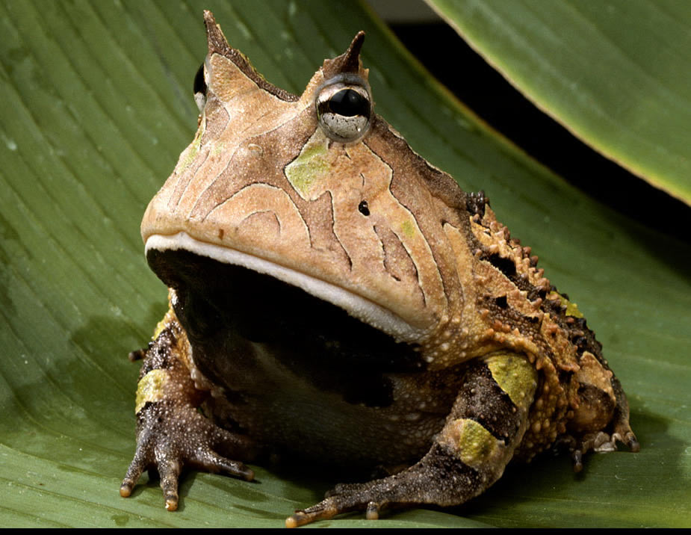
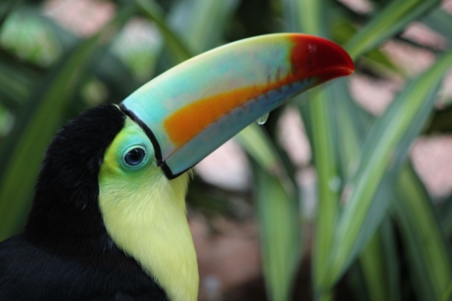
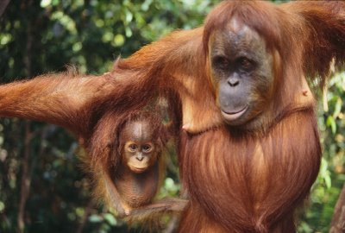
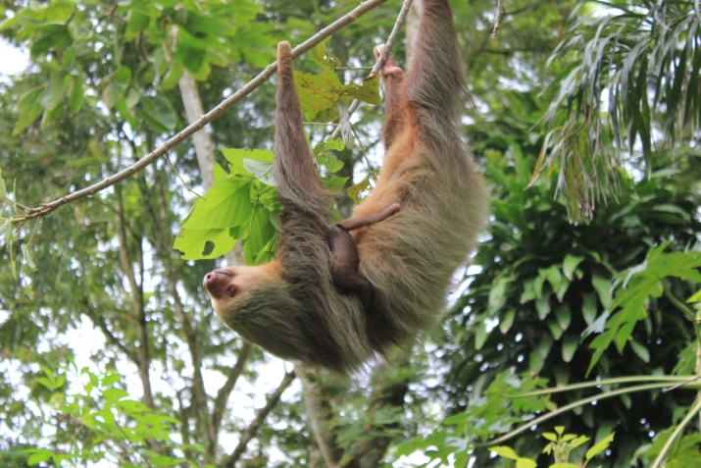
Consequences of lost of Biodiversity on Tropical Rainforests
Francisco Brenes
Laurens van Veen

Slide 2
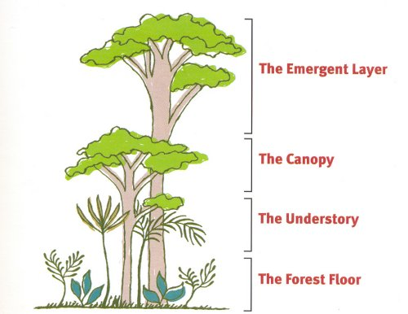
Decrease on forest layers (flora may even suffer extinctions)

Slide 3
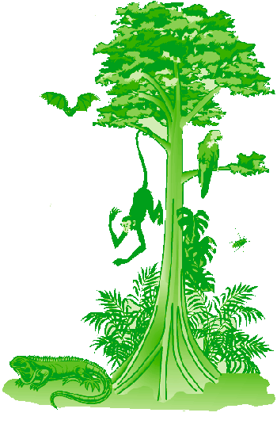
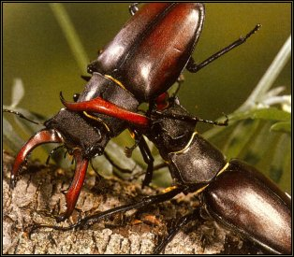
Makes ecosystem less stable and more vulnerable to diseases, competition, and extinction (ecosystem would collapse)

Slide 4
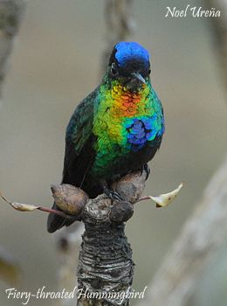
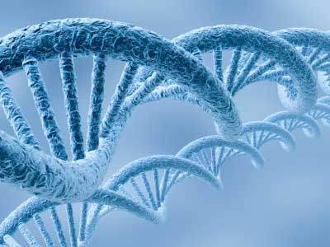
Depletion of the region’s genetic bank (many species are endemic to the rainforest areas)

Slide 5
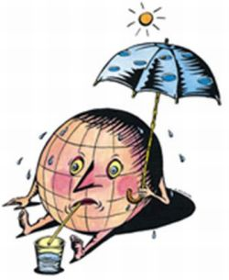
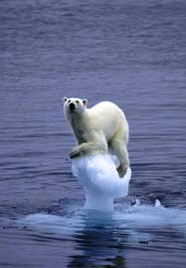
Increased levels of CO2 (higher amount of greenhouse gases-> higher Global Warming)

Slide 6

Reduced levels of O2 (rate of photosynthesis is reduced)

Slide 7
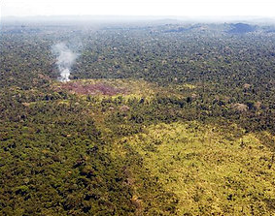

Decreased precipitation due to a reduced vegetation cover

Slide 8
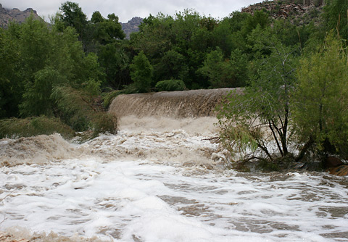
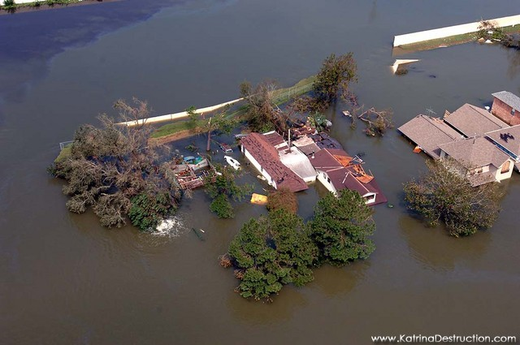
Reduced interception capacity leading to greater likelihood of flooding

Slide 9
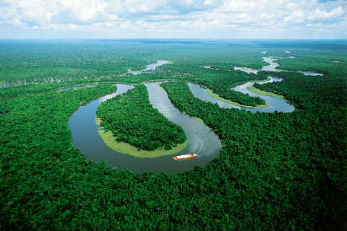
The ultimate alteration of the Amazon’s and other tropical rainforest’s discharge regime and sediment transport pattern

Slide 10
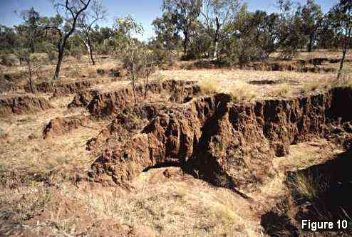
Severe soil exhaustion and erosion

Slide 11
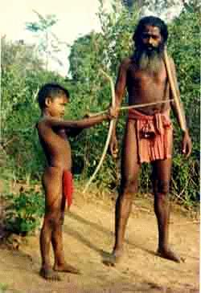
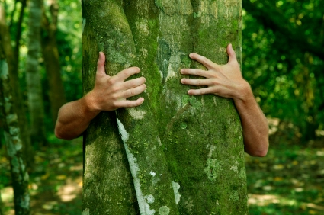
The adverse impact on the indigenous population

Slide 12

THANKS!

